Slide 1




AI-detecting allergy patch
Kadi Meshal Al-Otaibi
Lujain Rafa Al-Amri

Slide 2
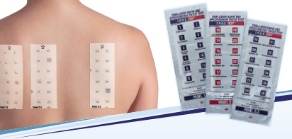
Allergy patch
https://www.newcastleskinmedical.com.au/patch-testing

Slide 3
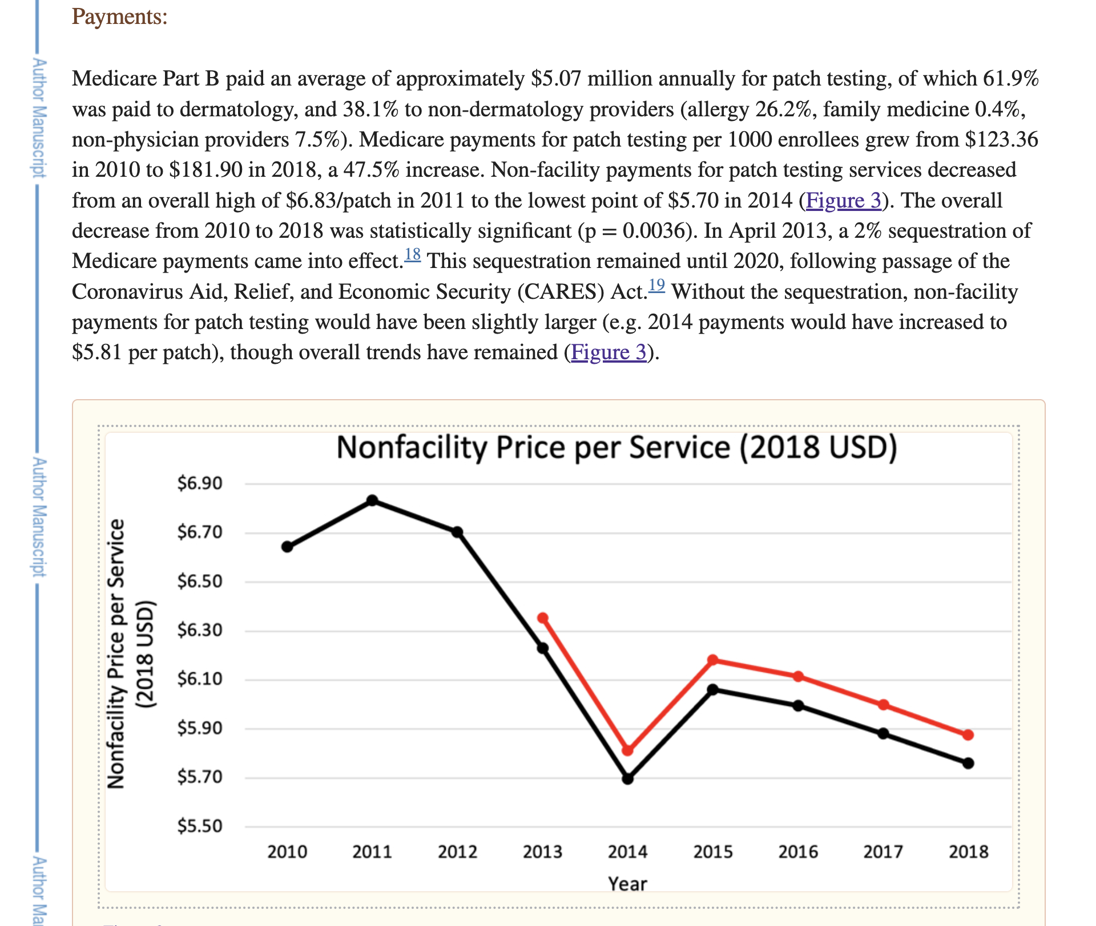
https://www.ncbi.nlm.nih.gov/pmc/articles/PMC8655313/

Slide 4
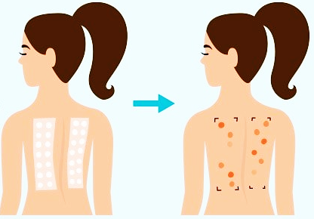
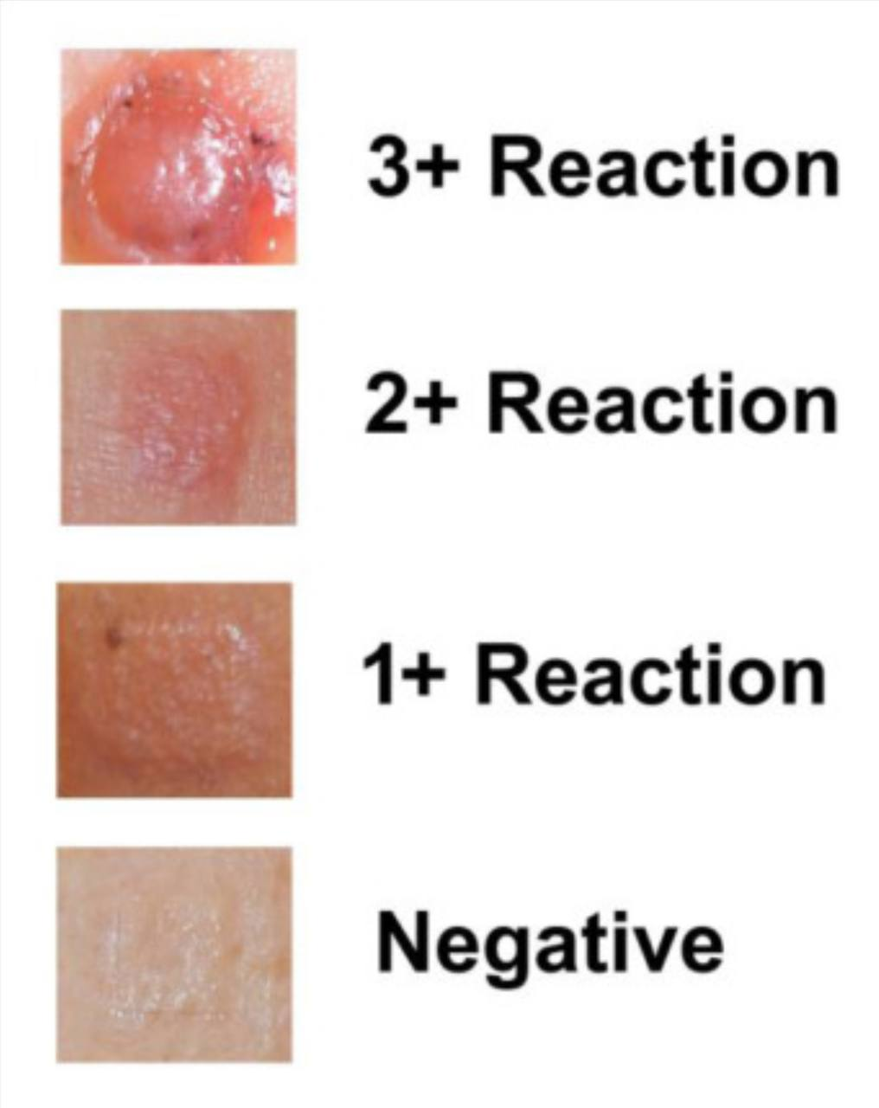
https://www.lovelyskin.com/blog/p/how-to-patch-test-skin-care
https://www.sciencedirect.com/science/article/abs/pii/S0738081X2100050X

Slide 5
Thank you!

